Slide 1

UNIVERSITY INSTITUTE OF SCIENCES
Academic Unit V
Bachelor of Engineering
(Computer Science & Engineering)
Biology For Engineers
23SZT148
Electrical stimulus and biophysical activity
Electrical activity of heart (ECG)
Electrical activity of brain (EEG)
DISCOVER . LEARN . EMPOWER

Slide 2
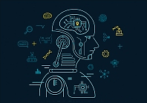

Course Outcome
CO Number | Title | Level
CO1 | Identify the biological concepts from an engineering perspective. | Remember
CO2 | Development of artificial systems mimicking human action. | Understand
CO3 | Explain the basic of genetics that helps to identify and formulate problems | Understand
CO4 | Apply knowledge of measurement system, biomedical recording system and biosensors to excel in areas such as entrepreneurship, medicine, government, and education. | Understand
CO5 | Integrate biological principles for developing next generation technologies
Will be covered in this lecture
https://images.app.goo.gl/5obqqxo93P2UBmdU6

Slide 3
SYLLABUS
Unit-3 | Bio Medical Instrumentation | Contact Hours: 15
Chapter 1 Electrical stimulus and biophysical activity Chapter 2 Biomedical recording system Chapter 3 Tissue Engineering | Electrical stimulus and biophysical activity: Patient, electrical shock and hazards, leakage current, Electrical activity of heart (ECG), Electrical activity of brain (EEG), Electrorentinogram (ERG), Electro-occologram (EOG), Electromyogram (EMG). Biomedical recording systems: Basic Recording system, General consideration for signal conditioners Preamplifiers, Differential Amplifier, Isolation Amplifier, Vectorcardiograph, Phonocardiograph, Other biomedical records, Patient isolation, and accident prevention. Tissue Engineering: Recombinant DNA technology, Stem cell biology & Tissue Engineering.

Slide 4
Biomedical Instrumentation
Biomedical instrumentation and engineering is the application of knowledge and technologies to solve problems related to living biological systems.
It involves diagnosis, treatment and prevention of disease in human.
As the medical field is emerging, the area of Biomedical Engineering is an expanding field.
When the discipline of engineering and medicine interacts, it is called Biomedical Engineering.

Slide 5
Medical Devices
A medical device is any device intended to be used for medical purposes.
Medical devices benefit patients by helping health care providers diagnose and treat patients and helping patients overcome sickness or disease, improving their quality of life.
It involves measurement of biological signals like ECG, EMG, or any electrical signals generated in the human body.
Biomedical Instrumentation helps physicians to diagnose the problem and provide treatment.

Slide 6
Electrical Medical Devices
Electrical activity of heart (ECG)
Electrical activity of brain (EEG)

Slide 7
Electrocardiogram (ECG)
An electrocardiogram (ECG or EKG) is a non-invasive diagnostic test that evaluates your heart's electrical signals to assess for different heart conditions.
Sensors (flat metal electrodes) attached to the skin are used to detect the electrical signals produced by your heart each time it beats.
Every heartbeat is triggered by an electrical signal that starts at the top of your heart and travels to the bottom.
Heart problems often affect the electrical activity of your heart.
Our nerve and muscle cells communicate with each other using electrical and chemical signals. Regular electrical signals also control our heartbeat.
An ECG measures these changes in electrical signals (or, in fact, voltage) and plots them as a graph (electrocardiograph).
The resulting ECG graph is called an electrocardiogram.

Slide 8
Electrocardiograph
Electrodes are placed on your chest to record your heart's electrical signals, which cause your heart to beat.
The signals are shown as waves on an attached computer monitor or printer.
Electrocardiographs are recorded by machines that consist of a set of electrodes connected to a central unit.
This is the graphic records of the variations in electrical potential caused by electrical activity of the heart muscle and detected at the body surface, as a method for studying the action of the heart muscle.
As the cardiac impulse passes through the heart, electrical currents spread into the tissues surrounding the heart, and a small proportion of these spreads all the way to the surface of the body.
If electrodes are placed on the skin on opposite sites of the heart, electrical potentials generated by these currents can be recorded; the recording is known as an electrocardiogram and abbreviated as ECG.

Slide 9
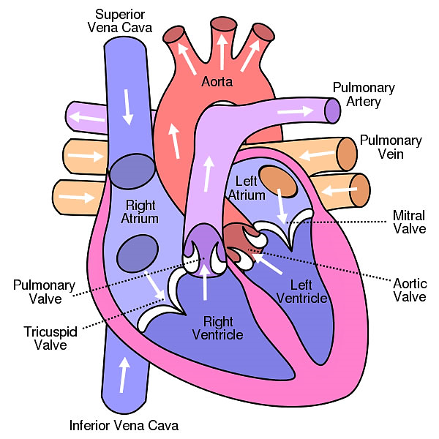
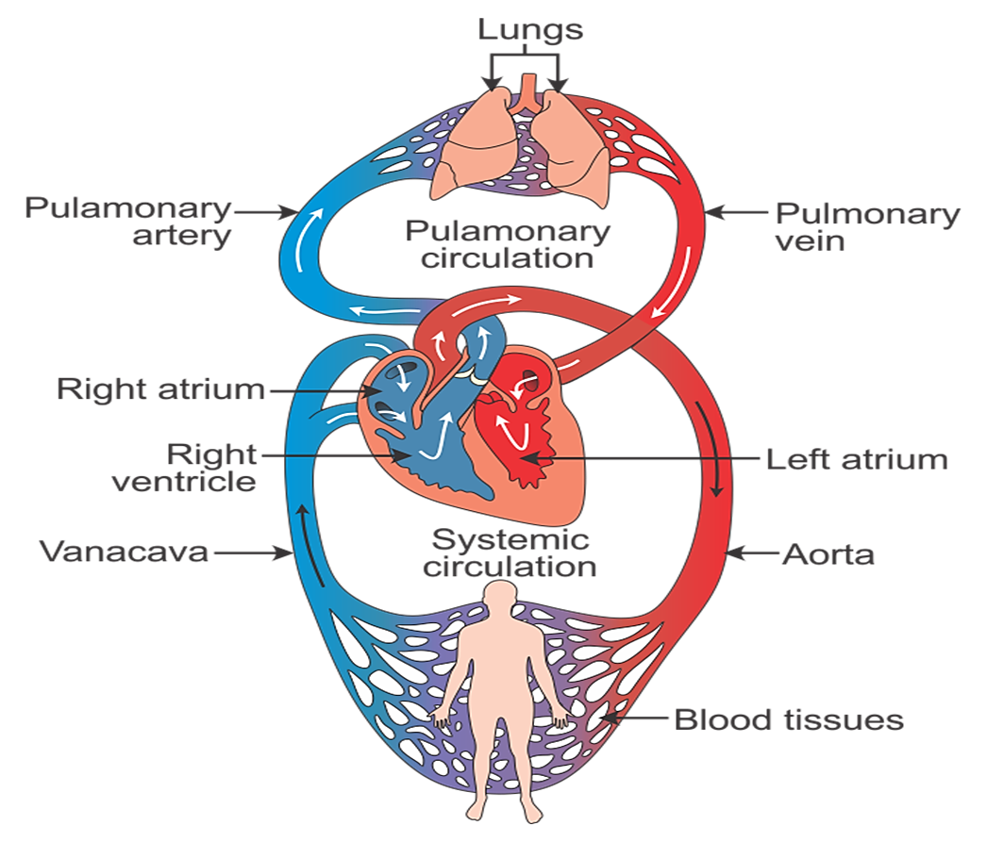
The heart is divided into four chambers consisting of two atria and two ventricles; the atria receive blood, while the ventricles pump blood.
The right atrium receives blood from the veins and pumps it to the right ventricle.
Aorta: the largest artery in the human body which carries the blood from the heart to all parts of the body except the lungs
The right ventricle receives blood from the right atrium and pumps it to the lungs, where it is loaded with oxygen.
The left atrium receives oxygenated blood from the lungs and pumps it to the left ventricle.
The left ventricle’s vigorous contractions create our blood pressure.
The left ventricle pumps oxygen-rich blood to the rest of the body.
Inferior vena cava: large vein that carries deoxygenated blood from the lower half of the body to the right atrium of the heart
Superior vena cava: large vein that carries deoxygenated blood from the upper half of the body to the right atrium of the heart
Lung congestion is is the main symptom of heart failure

Slide 10
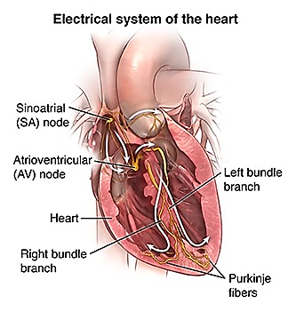
Electrocardiogram (ECG waves)
An electrocardiogram is the measure of electrical activity of the heartbeat.
The electrode combination records the difference of potential difference at two sites on the body.
The potential differences are produced due to the electrical activity of the heart.
The characteristic shape and timing of the ECG waves are due to the spread of wave of depolarization and repolarization associated with each heart beat.
With each beat, an electrical impulse (or “wave”) travels through the heart.
This wave causes the muscle to squeeze and pump blood from the heart.
A normal heartbeat on ECG will show the timing of the top and lower chambers.
Electrocardiograph is the machine
Electrocardiogram is the record

Slide 11
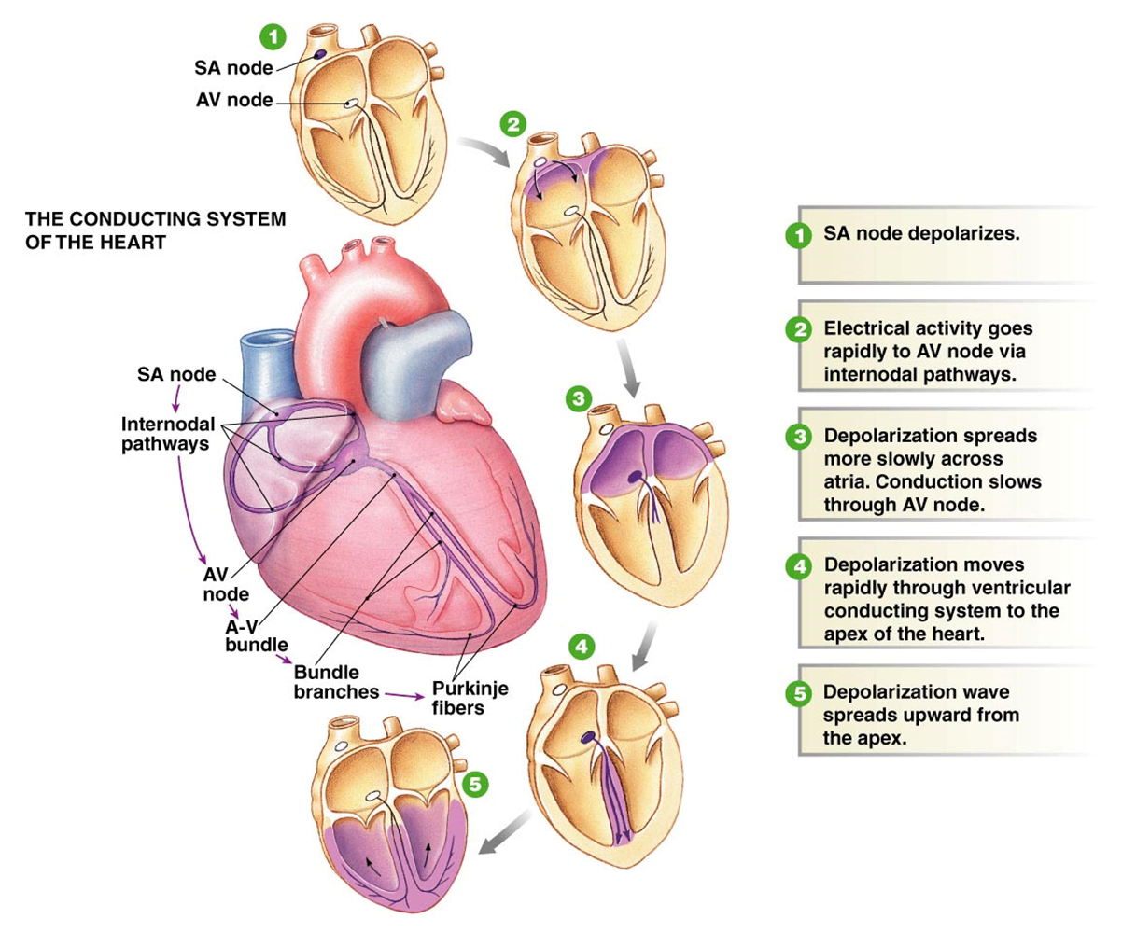
ECG
Regular electrical signals control our heartbeat.
These signals are sent by a group of cells in the right atrium of the heart known as the sinoatrial node (SA node): the primary pacemaker of the heart, and they spread through the heart muscle tissue as tiny electrical impulses.
This causes first the atria and then the ventricles of the heart to contract.
The way that these signals spread through the heart can also be measured on the surface of our skin.
An ECG measures these changes in electrical signals (or, in fact, voltage) on different areas of skin and plots them as a graph.
Notes:
AV Block: Impulse not reaching the AV node

Slide 12
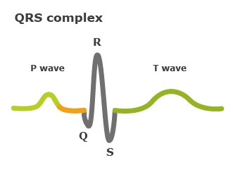
Electrocardiogram waves
The right and left atria or upper chambers make the first wave called a “P wave" — following a flat line when the electrical impulse goes to the bottom chambers.
The right and left bottom chambers or ventricles make the next wave called a “QRS complex."
The final wave or “T wave” represents electrical recovery or return to a resting state for the ventricles.
The normal ECG is composed of ‘P’ wave, a ‘QRS’ complex, and a ‘T’ wave.
The QRS complex is often three separate waves, the Q wave, the R wave and the S wave.
Time Measurements and Heart Rate Measurements are made horizontally on electrocardiogram.
P-wave
Depolarization of atria
Atria begin contracting about 25 msec after the start of the P-wave
QRS-complex
Ventricular Depolarization
Ventricles begin contracting shortly after the peak of the R wave
T-wave
Ventricular Repolarization
By counting the number of QRS complex, the heartbeat of a person can be determined

Slide 13
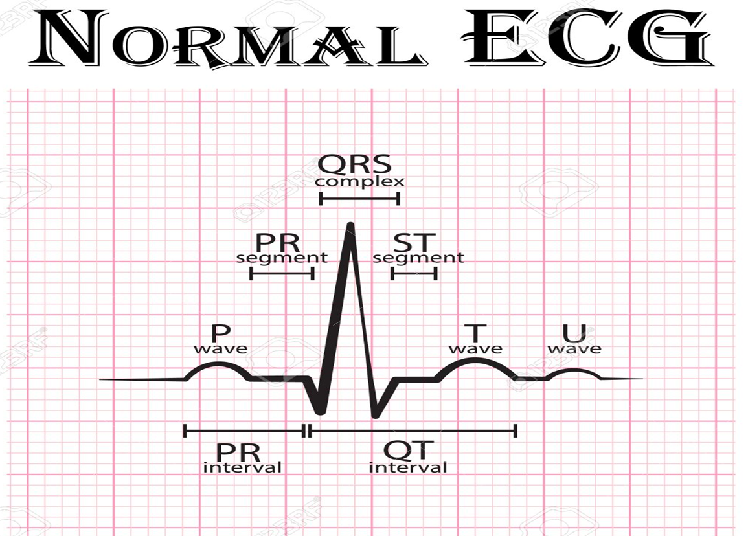
CHARCTERISTICS OF NORMAL ECG
The QRS complex is caused by potentials generated when the ventricles depolarize prior to contraction, that is as the depolarization wave spreads through the ventricles.
The T wave is caused by potentials generated as the ventricles recover from the state of depolarization. This wave is known as the “repolarization wave.”
‘U' waves are thought to represent the repolarization of the Purkinje fibers. However, the exact source of the U wave remains unclear.
Therefore, both the P waves and the components of the QRS complex are “depolariza­tion waves.”
Thus, the electrocardiogram is composed of both depolarization and repolarization waves.
The P wave is caused by electri­cal potentials generated as the atria depolarize prior to contraction.
Electrocardiogram intervals/segments
Segments – extend from the end of one wave to the start of another
P-R interval: Start of atrial depolarization to start of QRS
Q-T interval: Time required for ventricles to undergo a single cycle of depolarization and repolarization; measured from end of P-R to end of T

Slide 14
The Abnormal P wave: Elevation or depression of the PTA segment (the part between the P wave and the beginning of the QRS complex) can result from atrial infarction or pericarditis.
Enlargement of auricles can predicted by P wave
Shape of an abnormal QRS complex varies from almost normal to wide and bizarre and/or slurred and notched.
Tall QRS complexes are usually caused by hypertrophy of one or both ventricles, or by an abnormal pacemaker or aberrantly conducted beat.
T‐wave abnormalities in the setting of non‐ST‐segment elevation acute coronary syndromes are related to the presence of myocardial edema.
If the p-wave is enlarged, the atria are enlarged.
Duration of an abnormal QRS complex is greater than 0.12 seconds.
AV Block: Impulse not reaching the AV node.

Slide 15
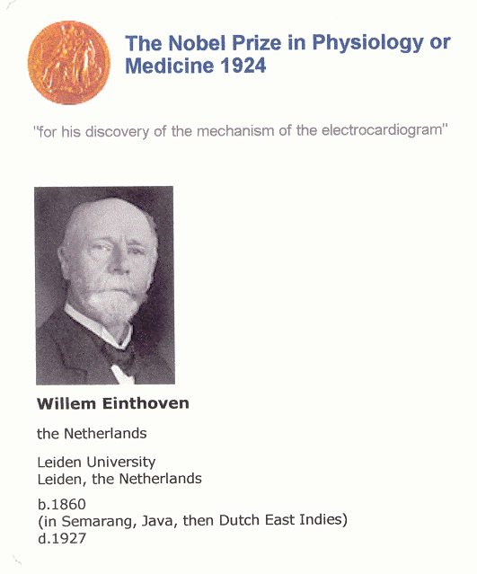
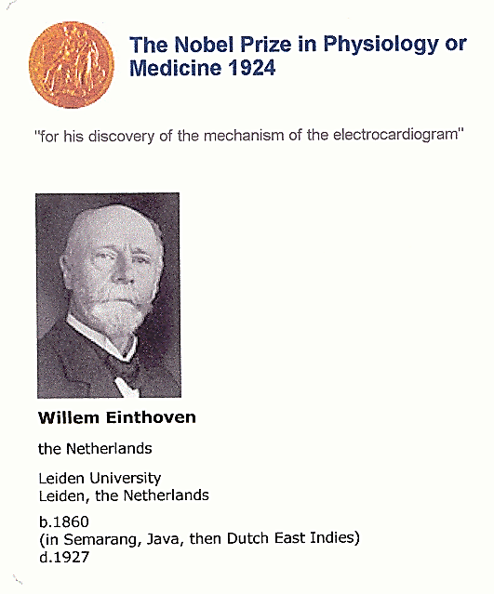
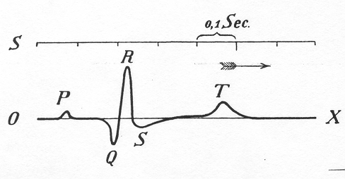
Why is it done?
An ECG gives two major kinds of information.
First, by measuring time intervals on the ECG, a doctor can determine how long the electrical wave takes to pass through the heart.
Second, by measuring the amount of electrical activity passing through the heart muscle, a cardiologist may be able to find out if parts of the heart are too large or are overworked.
Finding out how long a wave takes to travel from one part of the heart to the next shows if the electrical activity is normal or slow, fast or irregular.
The ECG is not only the oldest but, in fact, over 100 years after its introduction, continues as the most commonly used cardiovascular laboratory procedure.

Slide 16
WHEN ECG BEING DONE
An electrocardiogram is a painless, noninvasive way to help diagnose many common heart problems in people of all ages.
Your doctor may use an electrocardiogram to determine or detect:
Abnormal heart rhythm (arrhythmias)
If blocked or narrowed arteries in your heart (coronary artery disease) are causing chest pain or a heart attack
Whether you have had a previous heart attack
How well certain heart disease treatments, such as a pacemaker, are working.
You may need an ECG if you have any of the following signs and symptoms:
Chest pain
Dizziness, lightheadedness or confusion
Heart palpitations
Rapid pulse
Shortness of breath
Weakness, fatigue or a decline in ability to exercise

Slide 17
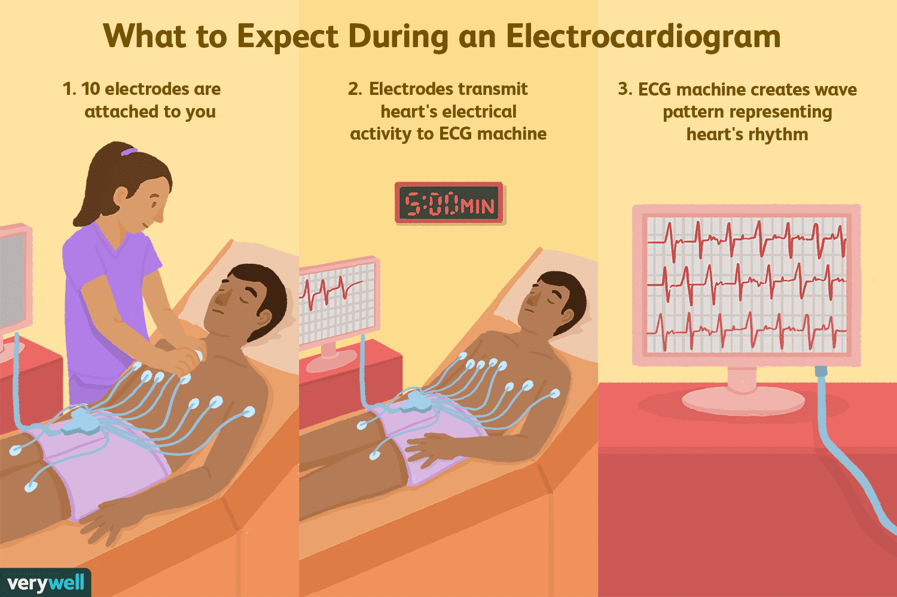
PROCEDURE OF ECG
The electrical activity of the heart can be measured on the surface of the skin – even as far from the heart as on your arms or legs. The standard “12-lead ECG” uses a total of ten electrodes: six on your chest, and then one each on your lower arms and calves.
During the test you'll lie flat while a computer creates a picture, on graph paper, of the electrical impulses that move through your heart.
It takes about 10 minutes to attach the electrodes and complete the test, but the actual recording takes only a few seconds.
Your doctor will keep your EKG patterns on file so that he can compare them to tests you get in the future.
This is called a "resting“ EKG, although the same test may be used to check your heart while you exercise.

Slide 18
Electroencephalogram (EEG)
An EEG, or electroencephalogram, is a test that records the electrical signals of the brain by using small metal discs (called electrodes) that are attached to your scalp.
Your brain cells communicate with each other using electrical impulses. They’re always working, even if you’re asleep.
That brain activity will show up on an EEG recording as wavy lines. It’s a snapshot in time of the electrical activity in your brain.
An EEG is a test can detects abnormalities in your brain waves, or in the electrical activity of your brain.
The electrodes detect tiny electrical charges that result from the activity of your brain cells.
The charges are amplified and appear as a graph on a computer screen, or as a recording that may be printed out on paper. Your healthcare provider then interprets the reading.

Slide 19
EEG Procedure
The EEG has been used for many years and is considered a safe procedure. The test causes no discomfort.
The electrodes record activity. They do not produce any sensation. In addition, there is no risk of getting an electric shock.
You lie down on the exam table or bed, and a technician puts about 20 small sensors on your scalp.
Once the recording begins, you’ll be asked to remain still.
The technician may instruct you to do certain things while the test is in progress. They may ask you to lie still, close your eyes, breathe deeply, or look at stimuli (such as a flashing light or a picture), because these activities can change your brainwave patterns.
The machine is only recording the activity of the brain and doesn’t stimulate it.
These sensors, called electrodes, pick up electrical activity from cells inside your brain called neurons and send them to a machine, where they show up as a series of lines recorded on paper or displayed on a computer screen.
For instance when a person moves his arms and legs, the EEG generated from frontal lobe.
The placement of the electrodes on the cranium in order to take the EEG is called the montage.
The technician will measure your head and mark where to place the electrodes. These spots are scrubbed with a special cream that helps the electrodes get a high-quality reading
The position of each electrode is specified using the International 10/20 system. Each electrode site is labeled with a letter and a number. Even number denotes the right side of the head and odd number denotes the left side.

Slide 20
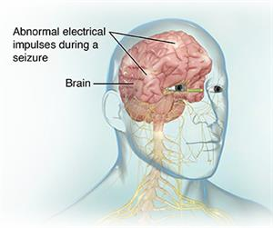
What does the EEG record?
Volume conduction
Ions are constantly flowing in and out of neurons to maintain resting potential and propagate action potentials.
In summary, the EEG signal represents the deflection of electrons on the scalp electrodes, caused by cortical “dipoles” (the summed activity within a specific area of cortex that creates a current flow).
Movement of like-charged ions out of numerous neighboring neurons can create waves of electrical charge, which can push or pull electrons on scalp electrodes, creating voltage differences.
EEG is the recording of the signal from dendrites of the pyramidal cells.

Slide 21
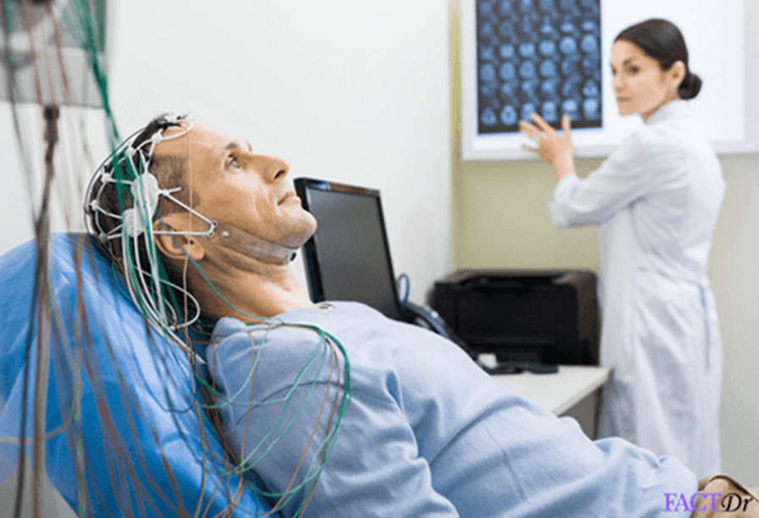
Why it's done
The EEG may also be used to determine the overall electrical activity of the brain (for example, to evaluate trauma, drug intoxication, or extent of brain damage in comatose patients).
EEGs are used to diagnose conditions like:
Brain tumors
Brain damage from a head injury
Brain dysfunction from various causes (encephalopathy)
Inflammation of the brain (encephalitis)
Seizure disorders including epilepsy
Sleep disorders
Stroke
An EEG may also be used to determine if someone in a coma has died or to find the right level of anesthesia for someone in a coma.
The test can also be used to diagnose other disorders that influence brain activity, such as Alzheimer's disease, certain psychoses, and a sleep disorder called narcolepsy.
The EEG may also be used to monitor blood flow in the brain during surgical procedures.
The EEG is used to evaluate several types of brain disorders.

Slide 22
REFERENCES
John G Webster, “Medical Instrumentation – Application and Design”, 4th ed., John Wiley and Sons, 2007.
Leslie Cromwell, Fred. J. Weibell, Erich. A. Pfeiffer, “Biomedical Instrumentation & Measurements, 2nd ed., Pearson Education., 2001.
Ryaby J.T. (2005) Biophysical Stimulation Using Electrical, Electromagnetic, and Ultrasonic Fields. In: Lieberman J.R., Friedlaender G.E. (eds) Bone Regeneration and Repair. Humana Press. https://doi.org/10.1385/1-59259-863-3:291
C.B.Powar, 2010.Cell Biology.5th Ed,Himalyan Publishing House.
Leshie Cromwell, Fred.J. Weibell and Erich.A.Pfeiffer. 2003. Biomedical instrumentation and measurements. 2nd edition, PHI.
John G. Webster 1998. Medical Instrumentation: Applications and Design, 3rd edition, Jon Wiley and Sons, New York.
Jeremy M. Berg, John L. Tymoczko and Lubert Stryer. 2006. “Biochemistry,” 6th Ed. W.H. Freeman and Co. Ltd.
Robert Weaver. 2012 “Molecular Biology,” 5th Edition, MCGraw-Hill.
Jon Cooper, , 2004. “Biosensors A Practical Approach” Bellwether Books.
Martin Alexander, 1994 “Biodegradation and Bioremediation,” Academic Press.

Slide 23
THANK YOU

